Slide 1
Persuasive Technology
Point systems
Nike+ /FitBit
Staircase
Speed Camera Lottery
Design Space – Mechanisms of Persuasion
Theoretcial Concepts:
Motivation: Intrinisic v. Extrinsic etc
Notes:
I think the “Design Space” analysis in Fogg’s list of techniques is pretty weak as design space analysis goes – but it does begin to lay out a space of possibilities.
My treatment of theory of motivation in this lecture is a bit abstract and partial – but I think the high-level distinctions it raises are an important starting point for analysis of persuasive technologies, which typically have, at their hear the motivational paradox of wanting to do something but finding it difficult to make yourself do it.

Slide 2
Nike+ GPS
Motivational tool for runners
Responds to users in a personal manner
Allows users to challenge themselves
Offers a history of what’s been done
Offers new goals when users feel they can do more
Vocal motivation
Users can share their feats
Notes:
This system has developed over several generations. It has a compendium of techniques, including those that are most prototypical of persuasive technologies at the time of writing.

Slide 3
Further Point Systems:
Musical Stairs
https://www.youtube.com/watch?v=2lXh2n0aPyw
Speed Camera Lottery
https://www.youtube.com/watch?v=iynzHWwJXaA
Notes:
Musical Stairs are a complex, playful example of Nudge, almost.
Speed Camera Lottery is close to Gamification.

Slide 4
7 Types of Persuasive Technology (Fogg, 2002)
Reduction
Tunnelling
Tailoring
Suggestion
Self Monitoring
Surveillance
Conditioning
Notes:
Here is Fogg’s Typology – really a list of “techniques” that persuasive technology might use.

Slide 5
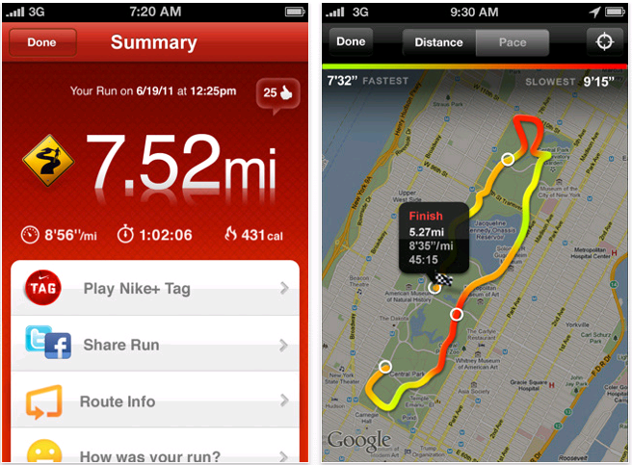
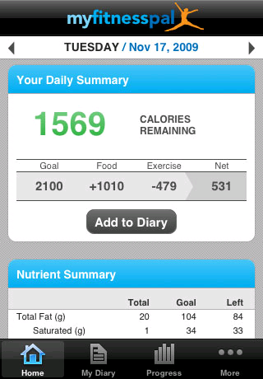
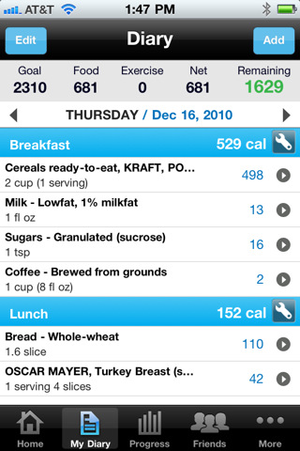
Types of Persuasive Technology Self Monitoring
Monitor themselves to modify their attitudes or behaviours to achieve a pre-determined goal.
Eliminates the tedium of tracking performance.
Nike+ GPS Calorie Counter
Notes:
In my intuitive rather than formal judgment, this is perhaps the single most widespread technique in behaviour-change applications.

Slide 6
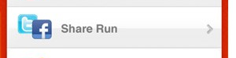
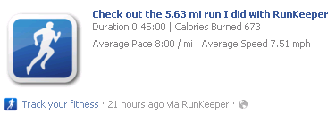
Types of Persuasive Technology Surveillance
Be persuaded by others
Allows individuals to learn about the behaviours of others
This increases the likelihood of achieving a desired outcome
Competitive Social Feedback
Notes:
This is a pretty widespread technique too – though Fogg’s name for it seems odd, and indeed misleading. Usually “surveliiance” is involuntary as far as the person under surveillance goes. Here it means, “sharing performance data”

Slide 7


Types of Persuasive Technology Reduction
Reduce complex behaviour to simple tasks
Facilitates user to achieve a goal
Increases the benefit/cost ratio of the behaviour
Influences users to perform the behaviour.
Notes:
It’s not clear to me that this is a “persuasive” technique, because it’s not clear it can encourage behaviours other than machine-interaction behaviours, and that’s not the usual domain of persuasive technologies. I think Fogg might be unhelpfully widening use of the term.

Slide 8
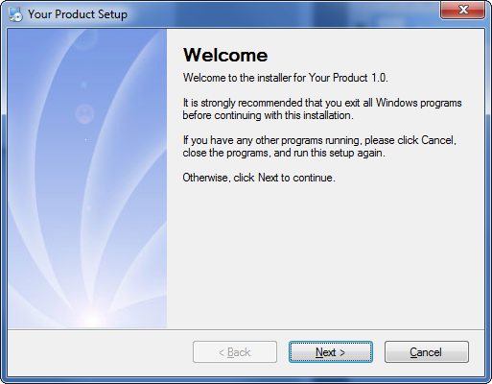

Types of Persuasive Technology Tunnelling
Guide users through sequence of actions
Facilitates user to achieve a goal
Easier to go through a process
Opportunities to persuade along the way
Notes:
Likewise, as with Reduction.

Slide 9
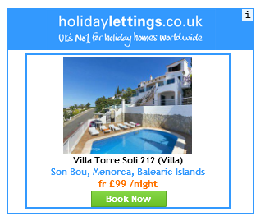



Types of Persuasive Technology Tailoring
Information is more persuasive if it is tailored to the individual’s:
Needs
Interests
Personality
Usage context
Cookies
Tailored Emails
Targeted Advertising
Notes:
I suppose this is true, but it’s hardly a technique (or a type)– it seems more a property of other techniques.

Slide 10

Types of Persuasive Technology Suggestion
Greater persuasive power if it offers suggestions at opportune moments
Suggestion technologies often build on people’s existing motivations
The suggested action must be timely and compelling enough that you implement it
Notes:
Intervening at the “Right Time” cv Nudge….chocolate bars at checkout counters, Rogers study of illuminated staircases.

Slide 11

Types of Persuasive Technology Conditioning
Operant conditioning to reinforce target behaviours when they occur
To be most effective, the conditioning must occur immediately after the behaviour (Positive reinforcement)
Motivational technique
Notes:
Operant Conditioning
Games use conditioning: in PacMan, when PacMan eats white pellets they gain points

Slide 12
Conditioning
Classical Conditioning
(a.k.a Pavlovian Conditioning)
Associating apparently unrelated stimuli and responses together
-Automatic, physiological
Operant Conditioning
Shaping behaviour using a system of rewards and punishments.
E.g. parenting/schooling

Slide 13
Gamification
Compare previous “types” with the idea of a game…
Scoring, monitoring, feedback, competition

Slide 14
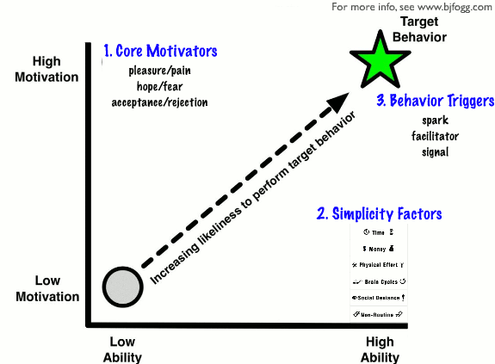
A Simplified Behaviour Model (Fogg, 2009)
People must have sufficient motivation, sufficient
ability and an effective trigger
Notes:
This is a simple, but I believe helpful model. It shows how internal motivations interact with external prompts to encourage action.

Slide 15
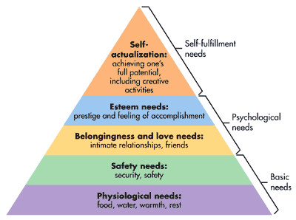
Motivation Maslow’s Hierarchy Of Needs (1943)
Motivation
The general desire or willingness of someone to do something
Notes:
This is the grand-daddy of theories of Motivation. It’s pretty self explanatory, but the key idea not obvious from the diagram is that lower level needs dominate behaviour until they are satisfied.

Slide 16
Conceptualising Motivation
Approach v. Avoidance
Intrinsic v. Extrinsic
Intrinsic Motivation decreased by Extrinsic rewards
(But this generalization is controversial, e.g. Ryan & Deci, Review of Educational Research, 1996)
Intrinsic Motivation increased by:
Challenge
Self-efficacy (Bandura)
Notes:
Here are some important distinctions.
Intrinsic motivations are motivations like fun, interest,
Extrinsic motivations are not particular to the activity, such as rewards, points.

Slide 17
Mastery versus Performance
Mastery = ‘for its own sake’
Performance = towards performance indicators
Motivators v. Hygiene Factors (Herzberg)
Goal setting (Locke), Goal commitment
Implementation Intentions (e.g. Gollwitzer, 1999)
Notes:
The distinction between motivators and hygiene factors is a distinction between motivations that act as a continuous drive and those that act instead as a step function (Hygiene Factors). For example, Herzberg claims that pay works as a hygiene factor. People are motivated to work for more pay, until a threshold is reached, beyond which gains are not effective motivators.
An implementation intention is an encoding of an intention with a very specific external prompt. E.g. When the clock strikes six I will sit at my desk and work.

Slide 18
Types of Persuasive Technology?
Argument
Exposure
Social Influence
Authority
Peer-influence
Identity
Notes:
This list is a list of types of persuasion. Is it an alternative kind of scheme to Foggs for types of persuasive technology technique?

Slide 19
References
Fogg, B. J. (2002). Persuasive technology: using computers to change what we think and do. Ubiquity, 2002(December), 5.
Fogg, B. J. (2009, April). A behavior model for persuasive design. In Proceedings of the 4th international conference on persuasive technology (p. 40). ACM.
Malone, T. W. (1982, March). Heuristics for designing enjoyable user interfaces: Lessons from computer games. In Proceedings of the 1982 conference on Human factors in computing systems (pp. 63-68). ACM.
Wai, C., & Mortensen, P. (2007). Persuasive technologies should boring. In Persuasive Technology (pp. 96-99). Springer Berlin Heidelberg. (Case study of Nike +)

